Slide 1
Travel Planner
CS 225 Final Project FA22

Slide 2
Our Team
Kathryn Thompson
Frank Lu
Shriya Surti
Neha Valavala

Slide 3
Goals

Slide 4
Through this project, we wanted to create a Travel Planner that helps travelers decide where they want to go based on their current location and how far they wish to travel.
Source
distance
Destination

Slide 5
Overview
Objectives:
Graph Implementation
BFS
Dijkstra’s Shortest Path
Betweenness Centrality

Slide 6
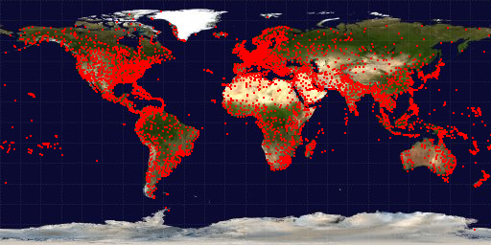
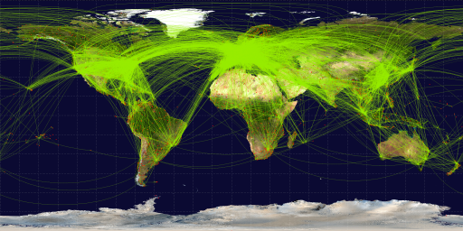
Data
From the OpenFlights Database
Airports Data
The database contains data about the airports around the world.
Only used the "Airport ID", "City", "Country", "Latitude", and "Longitude" properties of each entry.
Routes Data
The database contains data about flight routes that connect airports
Only used the "Source airport ID", "Destination airport ID", and "stops".
Notes:
Shriya: We first used two of OpenFlights datasets, the routes dataset as well as the airport dataset. The route dataset provides us with 67k entries providing information on the Airline, Airline ID, Source Airport, Court Airport ID, Destination Airport, Destination ID, Codeshare, Stops, and Equipment. We planned on using the Source and Destination airports, and the Stops to get strictly directly flights. For the airport database we are given 10k entries including the airport ID, Name, City, Country, IATA code, ICAO code, Latitude, Longitude, Altitude, Timezone, Daylight Savings Time, Timezone Type and Source. We chode to just use the Airport ID, Latitude, and Longitude to find the distance between each airport.

Slide 7
2. Development

Slide 8
Data Structure
Class
TravelGraph
Classes:
Travel Graph
Airport
BFS
Shortest
Class
BFS
Struct
Airport
Class
Shortest Path
Notes:
We decided to create three class

Slide 9
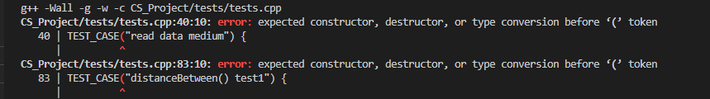
Challenges
Creating the Makefile
Planning how to implement the adjacency list
Test Cases and Linker Errors
Collaborating on GitHub
Planning the Travel Planner’s functionality
Notes:
Many of our challenges involved the syntax for the makefile as well as the test cases and linker errors. For the majority of our team we have never handled a makefile before so this was something that we all we able to learn how to create from scratch. We also encountered numerous issues with our test cases when we were reading from files. Many of the data points requires double quotations enclosing a point which took a very long time in debugging. However, we would consider these small challenges in comparison to conceptually understanding the adjacency list and how it would hold our a vector of pairs of airports and its distances between adjacent airports and how it compared to other implementation such as a matrix or a map. Another issue we encountered was when trying to collaboratively code within github’s codespaces which often would cause issues when numerous people would want to commit at once or if people would be typing at the same time.

Slide 10
Resolutions
We resolved most of our issues by asking the CAs and TAs at office hours, especially errors with our test cases and Makefile.
After we were able to test our code, we had to debug, and change some of our graph implementation in order to get it to work correctly. Especially with the storing of the adjacency lists. We used a vector, but initially wanted to use a map. The problem was overloading the operator<() in our struct.
Further, collaborating over GitHub was a major challenge for us when everyone was working on code at the same time. However, with communication, we were able to resolve this issue.

Slide 11

Limitations
Shortest Path
Optimization
Testing edge cases

Slide 12
3. Conclusions

Slide 13
Travel Graph
Description: Most of our implementation is dependent on storing our data in the right way. So, the TravelGraph constructor is one of the most important parts of out Travel Planner.
Time Complexity: O(n^2)
Application: Stores the data in a graph using adjacency lists. This is the base of the map between airports that the user uses indirectly to plan their travel
Input: Two Files- one for the airports data, one for the routes data
Output: The constructor stores our data in a graph implemented as an adjacency list
Notes:
After cleaning the route and airport data we were able to call these functions within our Travel Graph implementation which would allow us to create and adjacency list using the source and destination airports and the distance in between each with our distanceBetween function. We found that with using all three helper functions for cleaning and parsing the data the time complexity for the Travel Graph constructor was O(n^2).

Slide 14
Shortest Graph (Dijkstra’s)
Description: Our shortest path algorithm finds the travel path with the shortest distance between the source and destination.
Time Complexity: O(V^2)
Application: In our trip planner, the user can choose to travel the shortest distance to their destination using this function
Input: Travel Graph, Source Airport, Destination Airport
Output: Vector of airports and their distance from the previous airport
Notes:
We decided to use Dijkstra’s algorithm to calculate the shortest path between a source and destination airport. The input includes the travel graph, source, and destination airport. Dijkstra’s then calculates the distance from all the vertices from the source and places them in a priority queue. Vertices get removed from the queue in the order of the closest locations outwards. Once the destination has been found, for all additional distances less than the current path, dijkstras will try to find a shorter path.

Slide 15
Betweenness Centrality
Description: Uses the Betweenness Centrality algorithm to find the level of connectedness of an airport
Time Complexity: O(VE + (V^2)log(V))
Application: The user can choose to go to a more ‘central’ or connected airport if they want more travel options
Input: Travel Graph, Airport
Output: How connected the airport is (scale of 0 to 1)

Slide 16
BFS
Description: A breadth first traversal of the Travel Graph
Time Complexity: O(V + E)
Application: The BFS helps the users know which airports they can travel to from the airport that they are currently at.
Input: Source Airport
Output: Vector of Airport IDs
Notes:
We also used a breadth first search to traverse through the whole graph. Every airport in the dataset that is connected to the source airport are

Slide 17
Reflections
Learning:
Apply theory we learnt in class
Work with and clean real life data
Working with a Makefile
Thoughts:
We underestimated the amount of work required to complete the project
When we expected to accomplish a lot more, and only recognized the limitations later
Extension:
(If we had more time…)
We would implement a shortest path algorithm that looks at stopovers instead of distance
We would the Betweenness Centrality function to allow users the choice to travel to a more connected airport
We would try to improve runtime and memory requirements
Notes:
Finally we would like to conclude with our final thoughts on the project. We definitely learned that the data structures and algorithms we learned within lecture, lab and implement within the MPs can be applied within our own personal projects and product development. We also learned about the other C++ components that we never had to work with beforehand such as creating a Makefile, writing our own test case and learning how to clean and parse through real life raw data. We definitely underestimated the amount of work needed to go into the final project but we learned how to manage our time as we went along. Moving forward, if we had more time, we would love to implement a shortest path algorithm that took into account any layovers instead of just distances. We also would also make the Betweenness Centrality function allow users the choice to travel through more connected airport hubs as they are more likely to have more flights. We would also like to improve our runtime and memory as currently our runtime is O(VE + (V^2)log(V)).

